Slide 1
AI based motion control initial version of drawing trajectory
10.15 Jin Lexuan

Slide 2
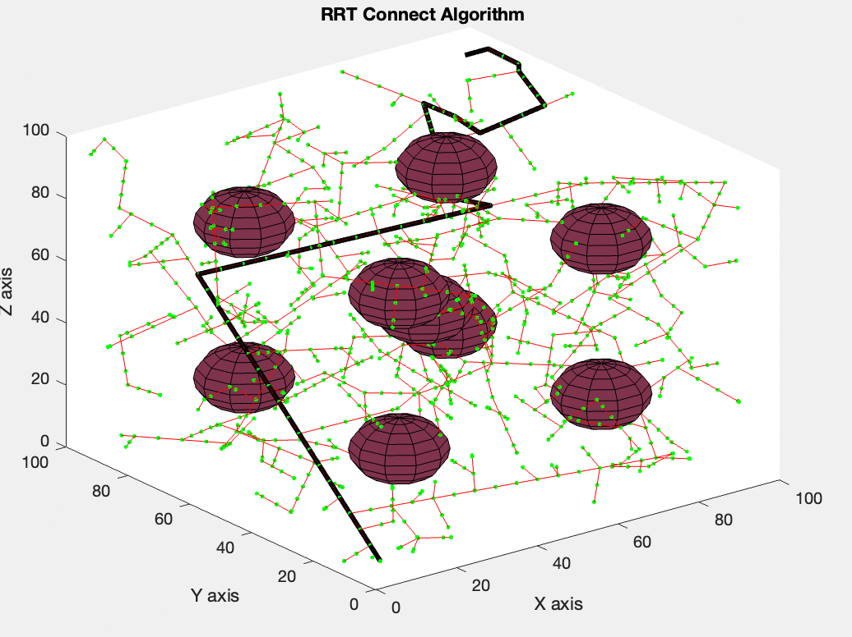
find the path of RRT
select the insection points from path
G
D
F
E
C
A to G in this figure
B
A

Slide 3

Transfer path to trajectory
Position $θ(t)=c_{0}+c_{1}t+c_{2}t^{2}+c_{3}t^{3}$
Speed $v(t)=c_{1}+{2c}_{2}t+3c_{3}t^{2}$
Accelaration $a(t)=2c_{2}+6c_{3}t$
Boundary conditions
derivation
 | Position | Velocity
t=0 | a | 0
t=T | b | 0

Slide 4
G
D
E
F
if we have A to G, 7 insection points, the we can get 6*3 polynomial
(6 section of path, 3 dimension)
Use those polynomial to generate the location of UAV of each second
then draw the trajectory
C
B
A

